Slide 1

Walking into the cave, Benandonner roared, ‘Right, where is he hiding?’
Pointing to the sleeping form of Fionn, Oonagh replied, ‘Be quiet or you’ll wake our baby!’

Slide 2
Thinking Fionn was indeed their child; Benandonner beat a hasty retreat as he did not want to wait around to meet the father. He was last seen running back across the causeway tearing it up at the spectacular coastline that is Fionn’s legacy to Ireland.

Slide 3
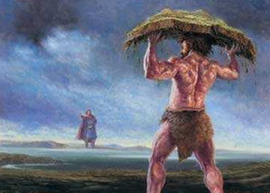

Slide 4
In fact, there is no known record of Fionn’s death. It is widely believed that he is not dead but has just faded away into the Other world where he sleeps peacefully to rise once again when Ireland needs him.

Slide 5
